Slide 1

WHAT IS AGILE:
Agile is a popular technology that allows you to build and respond to changes.
It is a collection of several principles that are used in the field of project management and software development.
This practice works on the continuous iteration of testing and development for the complete Agile software development lifecycle of a given business project.

Slide 2
What Is Agile Scrum Methodology
Agile scrum methodology is a sprint-based project management system with the goal of delivering the highest value to stakeholders.
Scrum is one of the many types of agile methodology, known for breaking projects down into sizable chunks called “sprints.” Agile scrum methodology is good for businesses that need to finish specific projects quickly.
the different roles in agile scrum methodology:
Scrum master: | Product owner:
The scrum master is the facilitator of the scrum development process. | The product owner represents stakeholders, who are typically customers.
The scrum master’s responsibilities also include coaching and motivating the team. | The product owner is also responsible for prioritizing goals for each sprint, based on their value to stakeholders, such that the most important and deliverable features are built in each iteration.

Slide 3
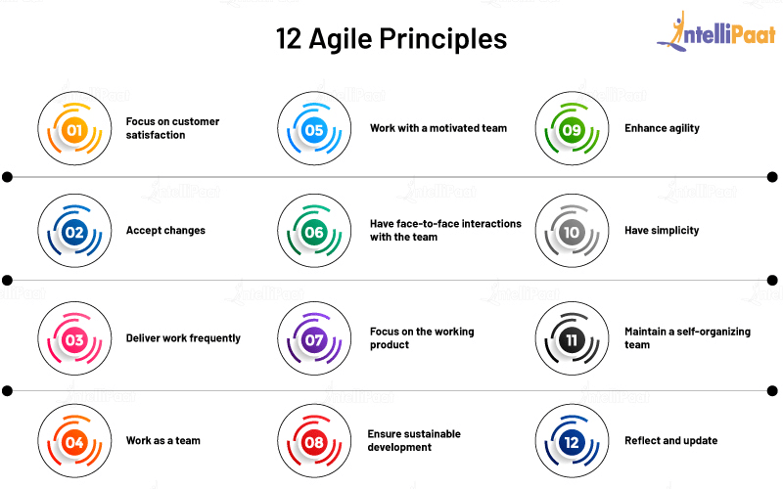

Slide 4
ADVANTAGES OF AGILE MODEL:
It allows interaction and collaboration between the project team and the clients.
It helps in providing transparency to the clients and offering them clear knowledge of the steps of project development.
The product is always delivered on time or early.
The product cost can be estimated.
Changes help in making an improved product.
The entire project is broken down into small parts that offer a better quality of development and testing.
DRAWBACKS OF AGILE MODEL:
In case of some software deliverables, especially the large ones, it is difficult to assess the effort required at the beginning of the software development life cycle.
There is lack of emphasis on necessary designing and documentation.
The project can easily get taken off track if the customer representative is not clear what final outcome that they want.
Only senior programmers are capable of taking the kind of decisions required during the development process. Hence it has no place for newbie programmers, unless combined with experienced resources.

Slide 5
Agile Modeling Embraces Five Values:
Communication: Agile modeling fosters communication between team members, developers, and stakeholders.
Simplicity: Models help simplify both the software and the software development process. Drawing a diagram that illustrates a concept or plan and the related growth can eliminate hours of unnecessary work and manual coding.
Feedback: Similar to the “communication” step, team members who use diagrams to communicate their ideas enable stakeholders to give fast feedback, which then cuts the project turnaround time.
Courage: Fortune favors the bold, and you need the courage to make the difficult decisions and change course, even if your team has already spent much time and resources on the work.
Humility: Although some iterations of Agile modeling values stop at four, other models include this fifth one. Humility shows that everyone on the team is essential and has equal value. Sometimes we can even be wrong! Humility, in this case, means respect for others’ ideas and suggestions and acknowledging the value of others’ contributions.

Slide 6
Extreme programming Principles:
The modeling embraces 11 core principles. You will notice many of the principles reference the five values we previously discussed.
Rapid feed back: Receiving timely feedback on the model closes the model’s loop of understanding.
Adopt simplicity: Keep the models as straightforward and uncomplicated as possible, and believe the simplest solution is also the best solution.
Incremental Change: t’s rare for a model to be complete on the first try. Models evolve as the project grows and develops.
Embrace Change: The more your understanding of a project grows, the more likely it will change.
Produce Quality Work: Nobody wants careless, rushed work . the developers here to produce a quality product.

Slide 7
KANBAN:
The Kanban framework helps in designing, managing, and making improvements in the flow of the system. Kanban allows companies to get a visual of their workflow and the work that is pending and needs to be done.
PRINCIPLES OF KANBAN:
Visualize the Workflow:To visualize your process with a Kanban system, you will need a board with cards and columns. Each column on the board represents a step in your workflow
Limit Work in Progress: Limiting WIP means implementing a pull system on parts or the complete workflow
Manage FloW : Managing the flow is about managing the work but not the people. By flow, we mean the movement of work items through the production process at a predictable and sustainable pace.
Feedback Loops: For teams and companies that want to be more agile, implementing feedback loops is a mandatory step. Kanban suggests the use of (feedback loops) at a team level as well as service-oriented cadences.

Slide 8
ADVANTAGES AND DRAWBACKS OF KANBAN
ADVANTAGES
DRAW BACKS
Flexibility
Focus on continuous delivery
Reduction of wasted work / wasted time
Increased productivity
Increased efficiency
Large-scaled production.
Cannot be used independently
Does not fit into a dynamic environment
Lack of timing

Slide 9

THANK YOU

